Slide 1
TRACTION ELEVATOR MODERNIZATION
Bid Comparison
Elevators at Adventist Health Tulare • 869 N. Cherry Street, Tulare, CA • 2 Traction Elevators (026858 / 026859)
Four Proposals Reviewed: Rise Up Elevator • TK Elevator (TKE) • Valley Elevator • Vertical Options
Prepared for Board Review — July 2026

Slide 2
Summary
Four contractors bid the same two-car traction modernization at Adventist Health Tulare
LOWEST TOTAL BID
Rise Up Elevator
TK Elevator (TKE)
Valley Elevator
Vertical Options
$625,790
$698,500
$938,950
$699,315
$625,790
Vertical Options LLC
Only bid with a fully NEW hoist machine included
Highest price; longest lead time; most equipment retained
Competitive price
Lowest price; most transparent scope/exclusions disclosure
$312,895 per elevator — 10% below the next-lowest bid, 33% below the highest
Recommendation
Vertical Options LLC offers the best value: lowest price while still replacing all major wear items (controller, motor, hoist ropes, governor, door operator) and including re-inspection fees that competitors bill separately.
Rise Up Elevator is the only bidder including a fully new hoist machine in its base price — worth considering if the District wants to eliminate all original mechanical equipment.
Traction Elevator Modernization — Bid Comparison | Adventist Health Tulare, 869 N. Cherry St.
2

Slide 3
Price Comparison
Total bid price for both traction elevators (base scope, before alternates)
Vendor | Total (2 cars) | Per Elevator
Vertical Options | $625,790 | $312,895
Rise Up Elevator | $698,500 | $349,250
Valley Elevator | $699,315 | $349,658
TK Elevator (TKE) | $938,950 | $469,475
Note: TKE's total includes a $9,300 performance/payment bond; the other three vendors do not state bond costs in their base price (bonds may be a required add-on).
Traction Elevator Modernization — Bid Comparison | Adventist Health Tulare, 869 N. Cherry St.
3

Slide 4
Scope Depth: New vs. Retained
What's actually being replaced for the price — the biggest driver of long-term reliability
Component | Rise Up | TK Elevator | Valley | Vertical Options
Controller | NEW (non-proprietary) | NEW (TKE TAC32T) | NEW (non-proprietary) | NEW (non-proprietary)
Hoist Machine | NEW | RETAIN (reseal) | RETAIN | RETAIN (+$61,718/ea to replace)
Motor | NEW AC | NEW AC | NEW AC | NEW AC
Governor & Ropes | NEW | RETAIN | RETAIN | NEW
Hoist Ropes | NEW | RETAIN | Not specified | NEW
Door Operator | NEW (GAL) | NEW (LD-16 Plus) | NEW | NEW (GAL MOVFR-II)
Car/Hall Fixtures | NEW, SS #4 | NEW, SS #4 | NEW | NEW, SS/LED
Cab Interior | RETAIN | NEW ($40K/ea allowance) | RETAIN | RETAIN (+$31.6-38.7K/ea alt.)
Rise Up is the only base bid with a fully new hoist machine. Rise Up and Vertical Options are the only two replacing the governor/ropes as standard scope.
Traction Elevator Modernization — Bid Comparison | Adventist Health Tulare, 869 N. Cherry St.
4

Slide 5
Inclusions, Exclusions & Warranty Terms
The fine print that changes the real cost and risk of each bid
Item | Rise Up | TK Elevator | Valley | Vertical Options
Permit assistance / inspection coordination | Yes | Yes | Not stated | Yes
Engineered drawings for OSHPD submittals (Any additional work required after HCAI/OSHPD submittals will be a change order) | Yes | Attachment calcs only | Yes | Yes
Failed-inspection re-test fee if not vendor's fault | Not stated | Billed to owner | Billed to owner | Included by vendor
Performance / payment bond | Not stated | Included ($9,300) | Not stated | Excluded, priced later
Cab interior refresh | Not included | Included ($40K/ea allowance) | Not included | Excluded — alternate priced
Warranty term | 1 yr — requires signed 5-yr service contract | 1 yr — requires TKE remain servicer | 1 yr new/refurbished parts | 1 yr — excludes retained hoist machine
Traction Elevator Modernization — Bid Comparison | Adventist Health Tulare, 869 N. Cherry St.
5

Slide 6
Project Timeline Comparison
Estimated weeks from material order through both elevators back in service (sequential installs)
Vendor | Est. Total Weeks
Vertical Options | ~22–28 wks
Rise Up Elevator | ~36–38 wks
TK Elevator (TKE) | ~58–70+ wks
Valley Elevator | Not detailed in proposal
TKE's 24–28 week fabrication time alone is longer than Vertical Options' or Rise Up's entire project. All figures exclude the OSHPD design/review phase, which every vendor lists as "varies" or "unknown."
Traction Elevator Modernization — Bid Comparison | Adventist Health Tulare, 869 N. Cherry St.
6

Slide 7
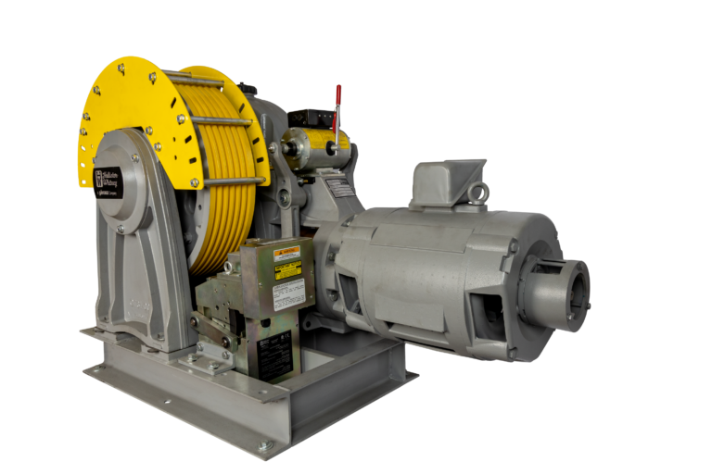
• The image below provides an example of a new hoist machine compared to the existing hoist machine currently in use.
• Notably, Rise Up Elevator is the only bidder to include new hoist machines as part of its base proposal.
New
Existing

